Slide 1
Projects
Weather Station
Ultrasonic Distance

Slide 2
Objectives
Arduino is great for sensing the environment
Our weather station will do the following:
Measure sunlight
Measure light sensor resistance (analog sensor)
Convert ohms to luminance (Lux)
Measure temperature (digital sensor)
Convert temperature °C to °F
Measure % humidity (digital sensor)
Output measurements to LCD Screen
Notes:
Point out that we’ve already measured voltage and resistance as earlier projects

Slide 3
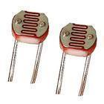
We Begin with a Photo Resistor
Gives indication of light level by changing the resistance

Slide 4
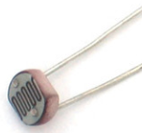
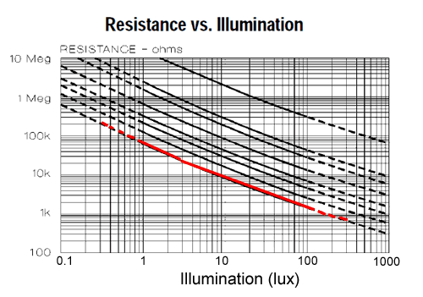
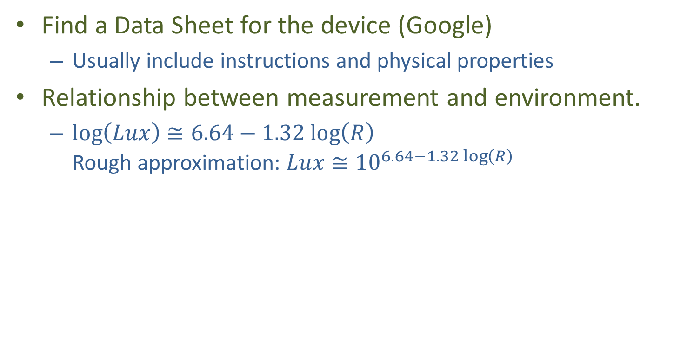
Sensors have Data Sheets
Find a Data Sheet for the device (Google)
Usually include instructions and physical properties
Relationship between measurement and environment.
$\log\left(Lux\right)≅6.64−1.32 log\left(R\right)$ Rough approximation: $Lux≅{10}^{6.64−1.32\log\left(R\right)}$
Resistance
Properties of several commercial devices
Our Device
Notes:
Slope=b=(log(y2)-log(y1))/(log(x2)-log(x1))
logy1=2, logy2=log(600000), logx1=4, logx2=-1
B=(5.78-2)/(-1-4)=-.756
Log(y)-log(y1)=b (log(x)-log(x1)
Or
Log(x)=log(x1)+(log(y)-log(y1))/b = 6.64-1.32 logR
Or with x=Lux and y=R
Log(Lux)=5-log(R)

Slide 5
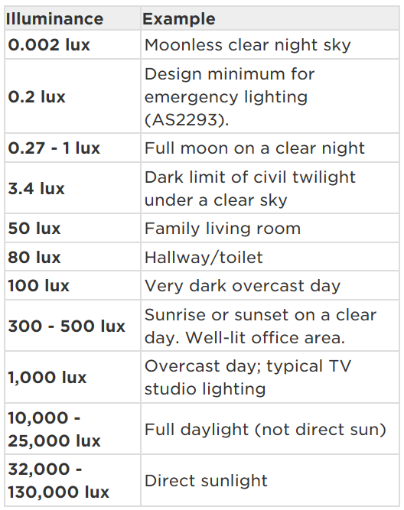

Lumen = intensity of perceived light
$$Lux=\frac{Lumen}{square meter}$$

Slide 6
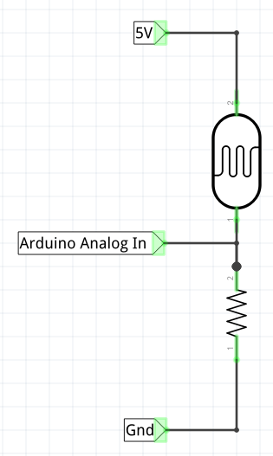
Photo Resistor AKA: Light Dependent Resistor (LDR)
We need to measure resistance
But Arduino can’t directly measure R
Use “voltage divider” along with our Ohmmeter sketch
Voltage V₀ depends on how much light is present
More light = less resistance → V₀ large
Less light = more resistance → V₀ small
R_{LDR}
V₀
R_{ref}

Slide 7
Code Snippet for Light Measurement
void loop() {
rawLight = analogRead(lightPin);
//convert raw analogin reading to resistance
Rldr = Rref * (1023.0 - rawLight) / rawLight;
//convert resistance to approximate Lux
Lux = pow(10.0, 6.64 - 1.32 * log10(Rldr));
}
Read about pow and log10 at http://www.cplusplus.com/reference/cmath/”

Slide 8
Advice
This Circuit is similar to OhmMeter
Unknown resistance is photoresistor
And now we use a 10K rather than 1K reference resistor
Better accuracy if ref resistor similar in size to unknown resistor.
Modify OhmMeter sketch and save it as WeatherStation

Slide 9
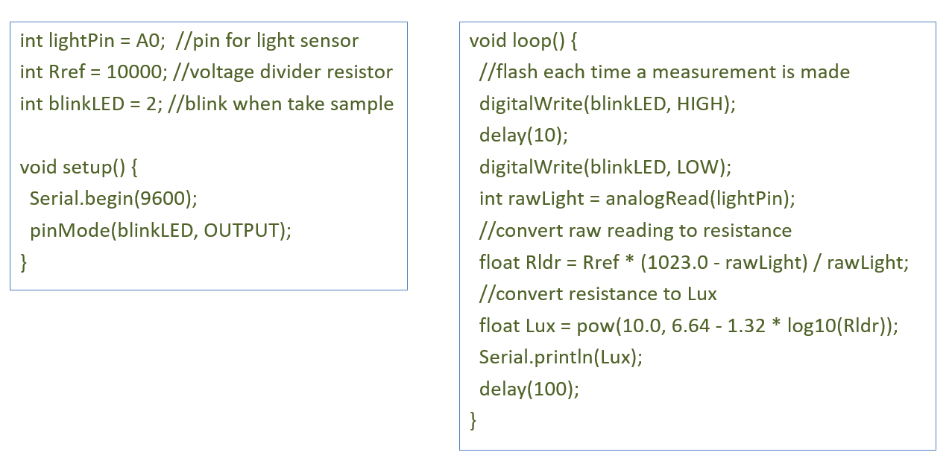
Sketch should look like this: (start typing)
(Answers folder: LightSensor.ino)

Slide 10
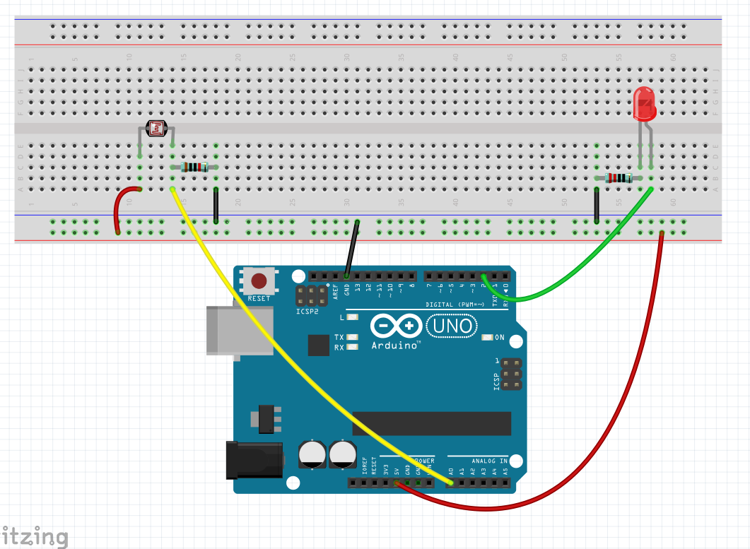
Build this: Light Sensor Circuit
Leave room for future development
10 k
220

Slide 11
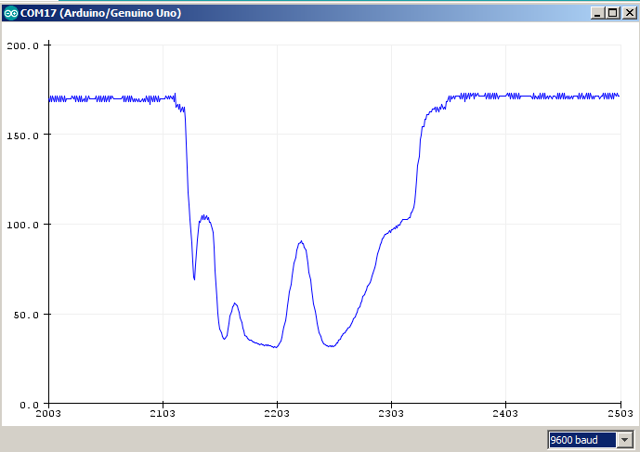
Try It!
Upload the code
Turn on Serial Monitor
Make sure it’s set to 9600 baud
Make a shadow over sensor
Turn off Serial Monitor
Turn on Serial Plotter
Tools -> Serial Plotter
Serial Plotter
Light Intensity (Lux)
Time (samples)
Make sure this matches value in your code: Serial.begin(9600)

Slide 12
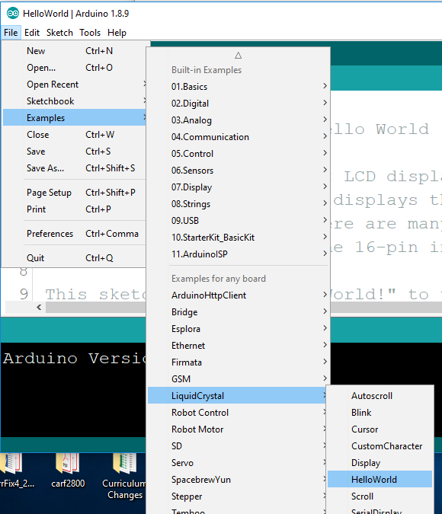
Using LCD: System Engineering
We may not know exactly how LCD works
We may not know exactly how Arduino works
But we know their interfaces
We can pull together many subsystems into a powerful complex system
How? Use Provided Examples!
File->Examples->LiquidCrystal

Slide 13
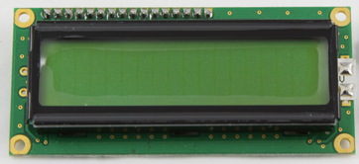
Modify the Program
These declarations are added:
#include <LiquidCrystal.h> //use the LCD library
LiquidCrystal lcd(7, 8, 9, 10, 11, 12); //define the Pin connections
Added to setup():
lcd.begin(16, 2); //our LCD has 16 columns and 2 rows.
Added to loop():
lcd.setCursor(0, 0);
lcd.print("Light(Lux) "); //initialize 16 characters
lcd.setCursor(11, 0);
lcd.print(Lux);}
Note:
These special functions are defined in the LiquidCrystal library
It’s easy to see what they do
They are easy to use
But details are beyond our scope
In Answers folder: LightSensorLCD.ino

Slide 14
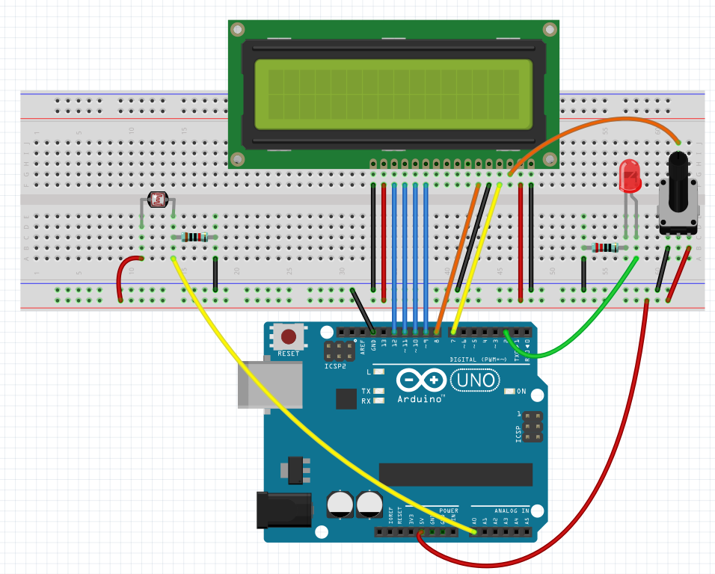
Now (carefully) Add an LCD
Wire Carefully!
Potentiometer
(Screen Contrast)

Slide 15
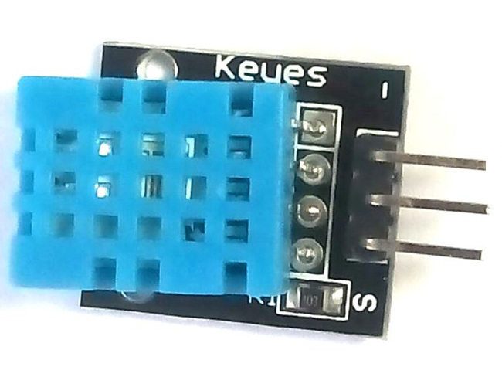
Temperature and Humidity
Find your DHT11 sensor
Has “embedded microprocessor”
Sends temp and humidity data serially as 0’s and 1’s over DATA pin
A Library is used to get the data
Specifications:
Temp: 0-50 °C
(32-122 °F)
Humidity: 20-90%
Response: 2 sec
(it’s slow)
GND
VCC
DATA

Slide 16
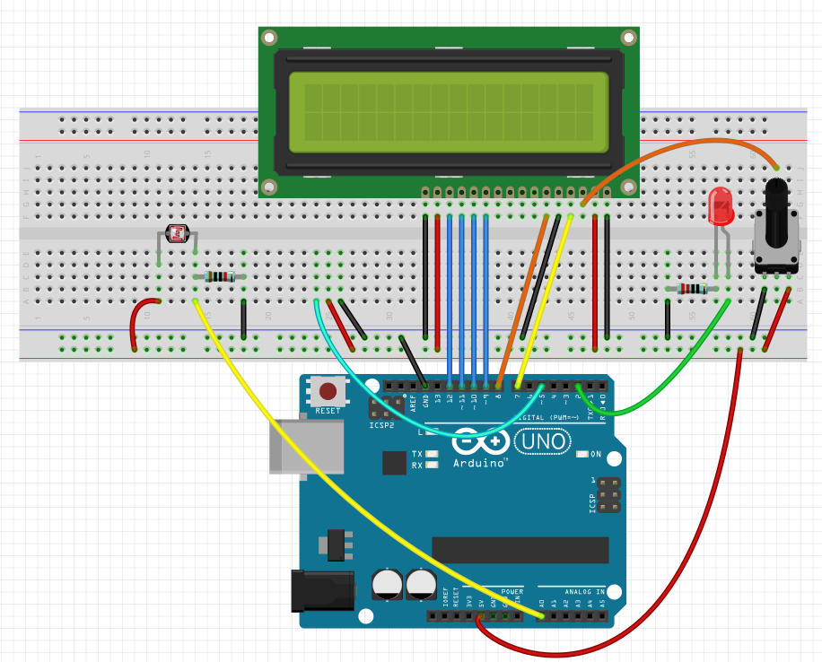
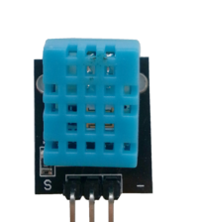
Add in the DHT11 sensor
Add These

Slide 17
DHT Library
You probably need to add the library: Sketch -> Include Library -> Manage Libraries…
It may already be installed on your system
In Library Manager: Filter Your Search
Type in: DHT
Select: SimpleDHT
Click: Install

Slide 18
Upload: “LightSensorLCD_DHT11.ino” (in Answers folder)
Additions made for the DHT11:
byte temperature = 0;
byte humidity = 0;
byte data[40] = {0};
if (dht11.read(pinDHT11, &temperature, &humidity, data)) {
Serial.println("Read DHT11 failed");
return;
}
int tempc = (int) temperature; //convert from byte to int
float tempf= temperature*1.8+32.0; //convert to deg F
int humid = (int) humidity; //convert from byte to int
This is a bit beyond our scope
Advice: Use this example as template for your own code
Example taken from our Elegoo tutorial CD

Slide 19
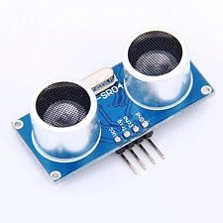
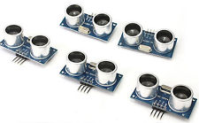
HC-SR04 Ultrasonic Distance Sensor
The Arduino Way!

Slide 20
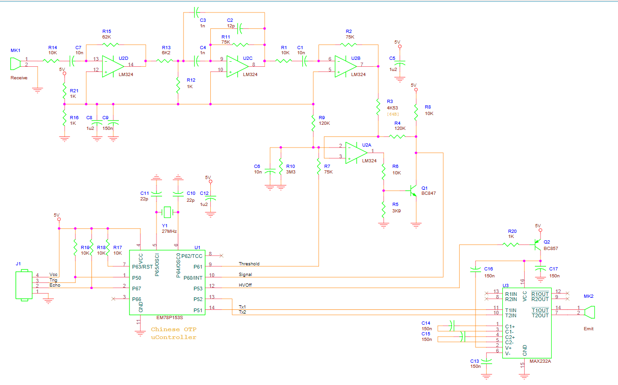

What’s Inside?
Lots! Good example of “Embedded System”
Transducers, amplifiers, filters, and..
Dedicated Microcontroller!
microcontroller
Systems within systems…
Notes:
uP handles comm with Arduino, generates transmit pulse, signal processes return pulse, handles echo pulse

Slide 21
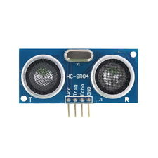
Distance Sensor HC-SR04 Review
Transmitter
Receiver
Trig
Echo
Range: 2 cm to 400 cm
Operates like this:
Arduino makes Trig pin go HIGH then LOW
HC-SR04 transmits 8 sound pulses at a rate of 40000 pulses per second (“ultrasonic”)
HC-SR04 makes Echo pin go HIGH until reflection detected, then pin goes LOW.
$$10 μs$$
Trig
Pin
Echo
Pin
T_{2way}
Ping
Transmitted
Echo
Received

Slide 22
Timing Diagram
10 μs
HIGH
Arduino pin connects to HC-SR04 Trig pin
LOW
8 sonic pulses
HIGH
Echo Detected
HC-SR04 sonic output
LOW
2-way travel time
HIGH
HC-SR04 makes Echo pin HIGH, then LOW when echo detected
LOW

Slide 23
Sound Velocity and Distance
HC-SR04
target
Receive
Transmit
Distance D
Total distance traveled by sound = 2D
“Two-Way” Travel time T_{2way} = 2D/V seconds
Sound velocity V ≈ 34.3 (cm/ms) at sea level
Or, V ≈ .0343 cm/us
Distance to Target: D = T_{2way}V/2 meters

Slide 24
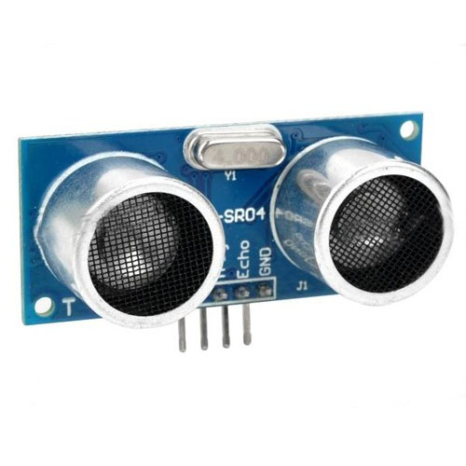

Using the Distance Sensor
target
“Min” surface = .5 m²
Receive
Transmit
The beam is narrow!
About $±15° (30° total)$
The target can’t be tilted!
HC-SR04
Little reflection
Soft targets – not so good

Slide 25
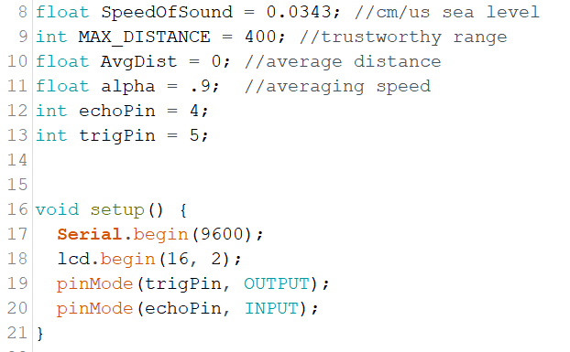
Code Walkthrough DistSensSkel.ino

Slide 26
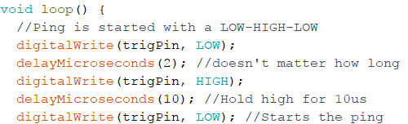
Initiate a Ping
$$10 μs$$
Trig
Pin
This causes HC-SR04 to send a PING
Echo
Pin
HC-SR04 sets “Echo” pin HIGH until return is detected
T_{2way}
Ping
Transmitted
Echo Detected

Slide 27
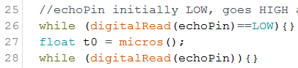
Wait for Echo
Here, we wait until echoPin goes LOW
Which indicates echo has been received
Echo
Pin
T_{2way}
t0
Ping
Transmitted
Echo
Detected

Slide 28
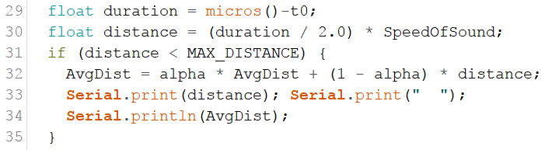
Compute Distance
Plot distance data using Serial Plotter
Echo
Pin
t0
duration=micros()-t0

Slide 29
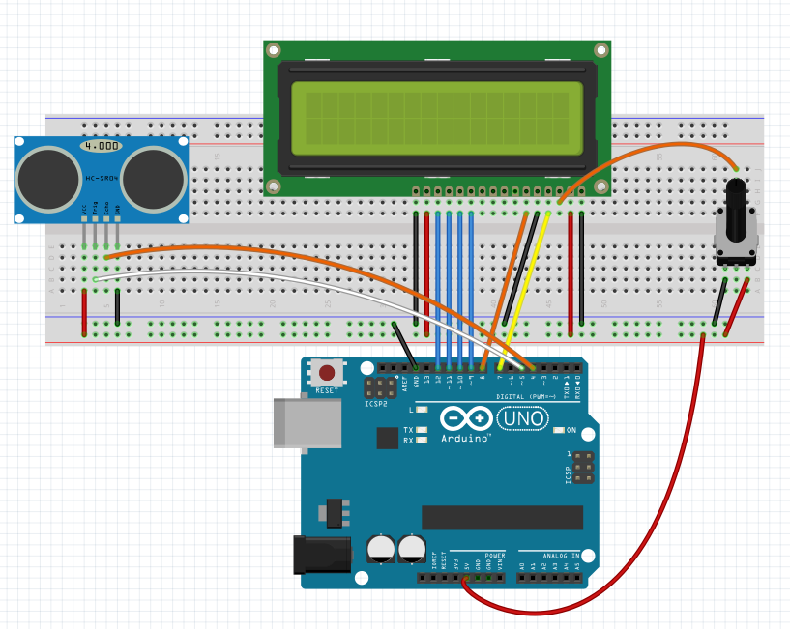
Make Your Circuit
pin 4 to “Echo”
pin 5 to “Trig”
Complete DistSensSkel.ino and upload it
Echo
Trig

Slide 30
Challenge! Make a Distance Alarm
Modify circuit:
Add one red LED plus 220 ohm resistor
Modify code:
Add “if” statement: if distance is less than 20 cm, turn on red LED, otherwise turn it off
Add a buzzer to the alarm

